Slide 1
Write the Title of Your Paper Here within Two Lines that Looks Beautiful
Authors: [Do not use Mr./Dr./Prof. etc.]
Author 1
Author 2
Author 3
Author 4
Presented by -
The Name of Presenting Author
Affiliation
Country

Slide 2
Contents of Presentation
Introduction
Problem Statement
Related work
Research Questions
Objectives
Methodology / System Architecture
Experimental / Simulation Results
Conclusions
Future Research Direction
References
Acknowledgment (if any)

Slide 3
Introduction
Use at least 20 font or more to present your words
Don’t write the full sentences to describe
Use figures, flow diagrams, images with few significant words to share your thoughts
You can emphasize words in a line using bold, coloured texts, or underlining them

Slide 4
Problem Statements
Example – “To improve communication and meet our targets, we must cut our turnaround time by half, improve response time, and follow through significantly. ”

Slide 5
Related Works
In the Related Works section, you should discuss briefly about published matter that technically relates to your proposed work.

Slide 6
Objectives
Mention the specific objectives for the audience
Specific objective clarifies what you have solved or searched for
Also it directs your results
Write the objectives in the following way
To determine the number of slides
To model the ppt slide
To evaluate the work with others

Slide 7
Methodology
A block diagram or flow-diagram can help to share your methodology without using hundred words

Slide 8
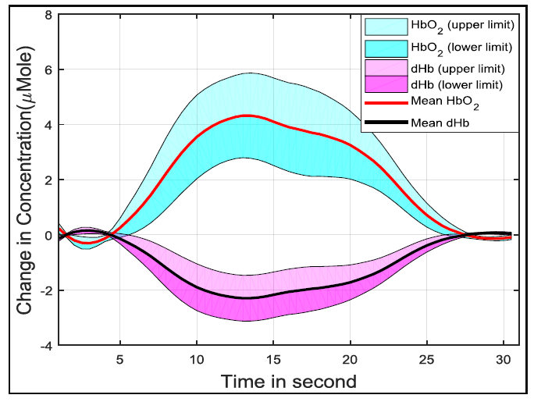
Results and Discussions
To show results use figures, tables, graphs with clear axis, legend, and scaling

Slide 9
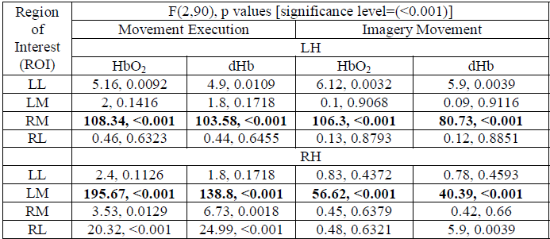
Results and Discussions – Cont’d
To present table, you may highlight the significant results. Also you may use image format of the table, it helps not to change the fonts

Slide 10
Conclusions
Point out your concluding remarks with significant outcomes and conditions
Also mention the limitations of your work
Make it simple and brief

Slide 11
Future Works
Write the future works and direction of future works
You should also give some recommendation for further work on the topic
Make it simple and brief

Slide 12
Acknowledgements
It is an often accepted manner to acknowledge the authority, organization, person, or others who directly or indirectly helps to conduct this research work

Slide 13
End Your Presentation
With
The Questioning Provision by the Audience

